Slide 1
Lecture 15
Inference
Yaohang Li
Department of Computer Science
ODU
Reading for This Class:
Chapter 7, 8, 9, Russell and Norvig

Slide 2
Review
Last Class
Knowledge-based Agents
Propositional Logic
This Class
Inference
Next Class
First Order Logic

Slide 3
Problem
Given:
KB: a set of sentences
α: a sentence
Answer:
KB α ?

Slide 4
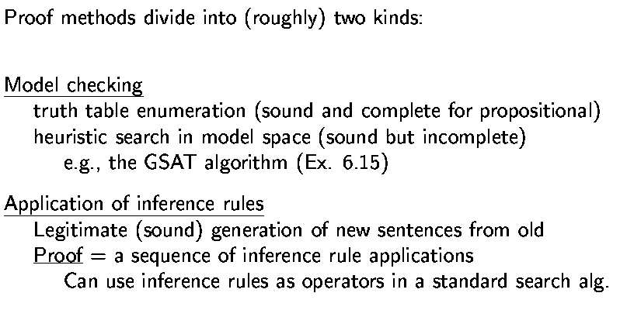
Proof Methods
Adapted from slides by S. Russell, UC Berkeley

Slide 5



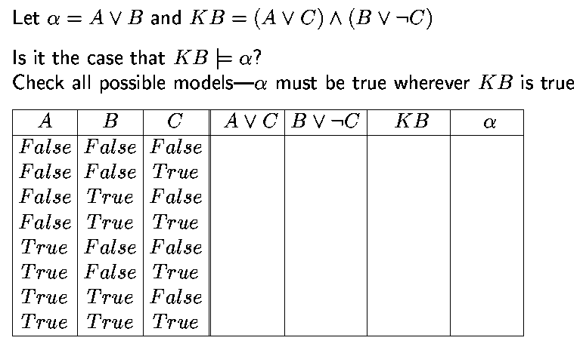

Propositional Inference: Enumeration (Model Checking) Method
Adapted from slides by S. Russell, UC Berkeley

Slide 6
Enumeration of Models
P: Set of propositional symbols in {KB,¬α}
n: Size of P
ENTAILS?(KB,α)
For each of the 2^{n} models on P do
If it is a model of {KB,¬α} then return no Return yes

Slide 7
Satisfiability Test as CSP
Each propositional symbol is a variable
The domain of each variable is {True, False}
Each sentence in {KB,¬α} is a constraint on the value(s) taken by one or several variables (e.g., P∨Q requires that P and Q do not take both the value False)
Recursive backtracking CSP techniques and heuristics are applicable, as well as local search (with min-conflict heuristic)

Slide 8
Inference Rule
⊥
An inference rule {ξ, ψ} ϕ consists of 2 sentence patterns ξ and ψ called the conditions and one sentence pattern ϕ called the conclusion
If ξ and ψ match two sentences of KB then the corresponding ϕ can be inferred according to the rule
Derive chains of conclusion

Slide 9
Example: Modus Ponens
{ α⇒β , α } β
⊥
{ξ, ψ} ϕ
⊥

Slide 10
Example: Modus Ponens
{ α⇒β , α } β
⊥
{ξ, ψ} ϕ
⊥
Battery-OK ∧ Bulbs-OK ⇒ Headlights-Work
Battery-OK ∧ Starter-OK ∧ ¬Empty-Gas-Tank ⇒ Engine-Starts
Engine-Starts ∧ ¬Flat-Tire ⇒ Car-OK
Battery-OK ∧ Bulbs-OK

Slide 11
Example: Modus Ponens
{ α⇒β , α } β
⊥
{ξ, ψ} ϕ
⊥
Battery-OK ∧ Bulbs-OK ⇒ Headlights-Work
Battery-OK ∧ Starter-OK ∧ ¬Empty-Gas-Tank ⇒ Engine-Starts
Engine-Starts ∧ ¬Flat-Tire ⇒ Car-OK
Battery-OK ∧ Bulbs-OK

Slide 12
Example: Modus Ponens
{ α⇒β , α } β
⊥
{ξ, ψ} ϕ
⊥
Battery-OK ∧ Bulbs-OK ⇒ Headlights-Work
Battery-OK ∧ Starter-OK ∧ ¬Empty-Gas-Tank ⇒ Engine-Starts
Engine-Starts ∧ ¬Flat-Tire ⇒ Car-OK
Battery-OK ∧ Bulbs-OK

Slide 13
Example: Modus Ponens
{ α⇒β , α } β
⊥
{ξ, ψ} ϕ
⊥
Battery-OK ∧ Bulbs-OK ⇒ Headlights-Work
Battery-OK ∧ Starter-OK ∧ ¬Empty-Gas-Tank ⇒ Engine-Starts
Engine-Starts ∧ ¬Flat-Tire ⇒ Car-OK
Battery-OK ∧ Bulbs-OK
Headlights-Work

Slide 14
Example: Modus Tolens
{ α⇒β , ¬β } ¬α
⊥
Engine-Starts ∧ ¬Flat-Tire ⇒ Car-OK
¬Car-OK

Slide 15
Example: Modus Tolens
{ α⇒β , ¬β } ¬α
⊥
Engine-Starts ∧ ¬Flat-Tire ⇒ Car-OK ¬Car-OK ¬(Engine-Starts ∧ ¬Flat-Tire)

Slide 16
Example: Modus Tolens
{ α⇒β , ¬β } ¬α
⊥
Engine-Starts ∧ ¬Flat-Tire ⇒ Car-OK ¬Car-OK ¬(Engine-Starts ∧ ¬Flat-Tire) ≡ ¬Engine-Starts ∨ Flat-Tire

Slide 17
Other Examples
⊥
{α,β} α ∧ β
{α∧β,.} α
{α∧β,.} β
Etc …
⊥
⊥

Slide 18
Inference
I: Set of inference rules
KB: Set of sentences
Inference is the process of applying successive inference rules from I to KB, each rule adding its conclusion to KB

Slide 19
Example
Battery-OK ∧ Bulbs-OK ⇒ Headlights-Work
Battery-OK ∧ Starter-OK ∧ ¬Empty-Gas-Tank ⇒ Engine-Starts
Engine-Starts ∧ ¬Flat-Tire ⇒ Car-OK
Headlights-Work
Battery-OK
Starter-OK
¬Empty-Gas-Tank
¬Car-OK

Slide 20
Example
Battery-OK ∧ Bulbs-OK ⇒ Headlights-Work
Battery-OK ∧ Starter-OK ∧ ¬Empty-Gas-Tank ⇒ Engine-Starts
Engine-Starts ∧ ¬Flat-Tire ⇒ Car-OK
Headlights-Work
Battery-OK
Starter-OK
¬Empty-Gas-Tank
¬Car-OK
Battery-OK ∧ Starter-OK ← (5+6)

Slide 21
Example
Battery-OK ∧ Bulbs-OK ⇒ Headlights-Work
Battery-OK ∧ Starter-OK ∧ ¬Empty-Gas-Tank ⇒ Engine-Starts
Engine-Starts ∧ ¬Flat-Tire ⇒ Car-OK
Headlights-Work
Battery-OK
Starter-OK
¬Empty-Gas-Tank
¬Car-OK
Battery-OK ∧ Starter-OK ← (5+6)
Battery-OK ∧ Starter-OK ∧ ¬Empty-Gas-Tank ← (9+7)

Slide 22
Example
Battery-OK ∧ Bulbs-OK ⇒ Headlights-Work
Battery-OK ∧ Starter-OK ∧ ¬Empty-Gas-Tank ⇒ Engine-Starts
Engine-Starts ∧ ¬Flat-Tire ⇒ Car-OK
Headlights-Work
Battery-OK
Starter-OK
¬Empty-Gas-Tank
¬Car-OK
Battery-OK ∧ Starter-OK ← (5+6)
Battery-OK ∧ Starter-OK ∧ ¬Empty-Gas-Tank ← (9+7)
Engine-Starts ← (2+10)

Slide 23
Example
Battery-OK ∧ Bulbs-OK ⇒ Headlights-Work
Battery-OK ∧ Starter-OK ∧ ¬Empty-Gas-Tank ⇒ Engine-Starts
Engine-Starts ∧ ¬Flat-Tire ⇒ Car-OK
Headlights-Work
Battery-OK
Starter-OK
¬Empty-Gas-Tank
¬Car-OK
Battery-OK ∧ Starter-OK ← (5+6)
Battery-OK ∧ Starter-OK ∧ ¬Empty-Gas-Tank ← (9+7)
Engine-Starts ← (2+10)
¬Engine-Starts ∨ Flat-Tire ← (3+8)

Slide 24
Example
Battery-OK ∧ Bulbs-OK ⇒ Headlights-Work
Battery-OK ∧ Starter-OK ∧ ¬Empty-Gas-Tank ⇒ Engine-Starts
Engine-Starts ∧ ¬Flat-Tire ⇒ Car-OK
Headlights-Work
Battery-OK
Starter-OK
¬Empty-Gas-Tank
¬Car-OK
Battery-OK ∧ Starter-OK ← (5+6)
Battery-OK ∧ Starter-OK ∧ ¬Empty-Gas-Tank ← (9+7)
Engine-Starts ← (2+10)
¬Engine-Starts ∨ Flat-Tire ← (3+8) ≡ Engine-Starts ⇒ Flat-Tire

Slide 25
Example
Battery-OK ∧ Bulbs-OK ⇒ Headlights-Work
Battery-OK ∧ Starter-OK ∧ ¬Empty-Gas-Tank ⇒ Engine-Starts
Engine-Starts ∧ ¬Flat-Tire ⇒ Car-OK
Headlights-Work
Battery-OK
Starter-OK
¬Empty-Gas-Tank
¬Car-OK
Battery-OK ∧ Starter-OK ← (5+6)
Battery-OK ∧ Starter-OK ∧ ¬Empty-Gas-Tank ← (9+7)
Engine-Starts ← (2+10)
Engine-Starts ⇒ Flat-Tire ← (3+8)

Slide 26
Example
Battery-OK ∧ Bulbs-OK ⇒ Headlights-Work
Battery-OK ∧ Starter-OK ∧ ¬Empty-Gas-Tank ⇒ Engine-Starts
Engine-Starts ∧ ¬Flat-Tire ⇒ Car-OK
Headlights-Work
Battery-OK
Starter-OK
¬Empty-Gas-Tank
¬Car-OK
Battery-OK ∧ Starter-OK ← (5+6)
Battery-OK ∧ Starter-OK ∧ ¬Empty-Gas-Tank ← (9+7)
Engine-Starts ← (2+10)
Engine-Starts ⇒ Flat-Tire ← (3+8)
Flat-Tire ← (11+12)

Slide 27
Soundness
An inference rule is sound if it generates only entailed sentences
All inference rules previously given are sound, e.g.: modus ponens: {α ⇒ β , α} β
The following rule: {α ∨ β , .} ¬α ∨ ¬β is unsound, which does not mean it is useless
⊥
⊥

Slide 28
Completeness
A set of inference rules is complete if every entailed sentences can be obtained by applying some finite succession of these rules
Modus Tolens alone is not complete, e.g.: from A ⇒ B and ¬B, we cannot get ¬A

Slide 29
Proof
The proof of a sentence α from a set of sentences KB is the derivation of α by applying a series of sound inference rules

Slide 30
Proof
The proof of a sentence α from a set of sentences KB is the derivation of α by applying a series of sound inference rules
Battery-OK ∧ Bulbs-OK ⇒ Headlights-Work
Battery-OK ∧ Starter-OK ∧ ¬Empty-Gas-Tank ⇒ Engine-Starts
Engine-Starts ∧ ¬Flat-Tire ⇒ Car-OK
Headlights-Work
Battery-OK
Starter-OK
¬Empty-Gas-Tank
¬Car-OK
Battery-OK ∧ Starter-OK ← (5+6)
Battery-OK ∧ Starter-OK ∧ ¬Empty-Gas-Tank ← (9+7)
Engine-Starts ← (2+10)
Engine-Starts ⇒ Flat-Tire ← (3+8)
Flat-Tire ← (11+12)

Slide 31
⇒ Connective symbol (implication) Logical entailment
Inference
KB α iff KB ⇒ α is valid
⊥
⊥
⊥
~ if sound

Slide 32
Summary
Propositional Logic
Syntax
Semantics
Model
Possible models
Model of a sentence
Model of a KB
Satisfiability
Validity
Inference

Slide 33
What I want you to do
Review Chapter 7, 8, 9
Work on your assignment
Work on your term project

